Slide 1


DevOps Engineer Internship
Name: Rimah Houssameldine & Wissam Hassan
University: Modern University for Business and Science
Major: Computer Science
Semester: Spring 2023-2024
Instructor: Dr. Zahi Zahreddine
Company: Park Innovation
Duration: Four Months

Slide 2
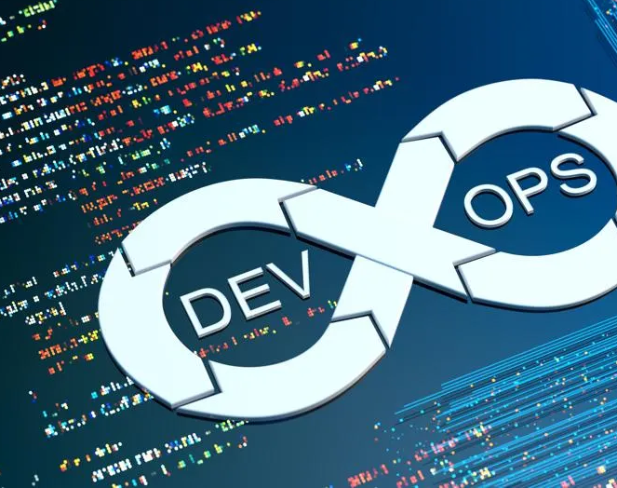
Embracing DevOps Practices
Version Control Systems (VCS): Git.
Continuous Integration (CI) and Continuous Deployment (CD): Jenkins.
Containerization: Docker.
Container Orchestration: Kubernetes, Docker Swarm.
Infrastructure as Code (IaC): Terraform, Ansible.
Scripting and Automation: Bash, PowerShell, Python.
Virtualization: VirtualBox, Vmware.
Monitoring and Observability: Prometheus, Grafana.
Source Code Management: GitHub, GitLab.
Cloud Platforms: AWS, Azure, Google Cloud Platform (GCP).

Slide 3

DevOps Concepts
Microservices Architecture
Serverless Computing
Immutable Infrastructure
Blue/Green Deployments
Canary Deployments
Infrastructure Scalability
High Availability (HA)
Disaster Recovery (DR)
Load Balancing
GitOps

Slide 4

Soft Skills
Communication
Collaboration and teamwork
Problem-solving
Time management
Adaptability and flexibility
Leadership and mentorship
Empathy and emotional intelligence

Slide 5



Modernizing Development and Deployment with DevOps
Welcome to our professional presentation on modernizing development and deployment processes with DevOps practices. Today, we'll showcase our journey of developing a PHP MySQL website and deploying it using CI/CD and IaC principles, both locally and on the cloud.

Slide 6

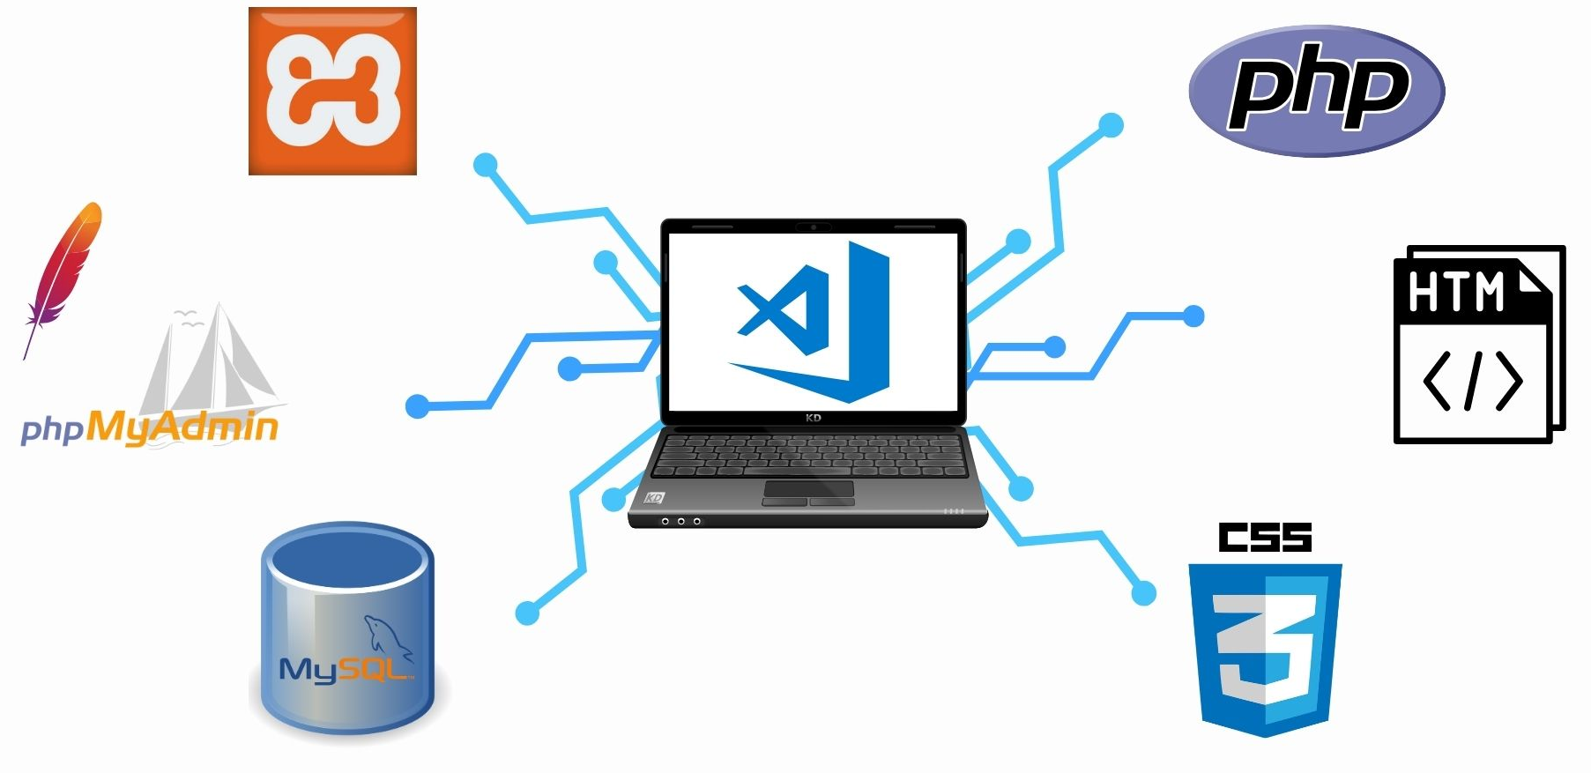
Application Architecture
Streamlining Collaboration

Slide 7
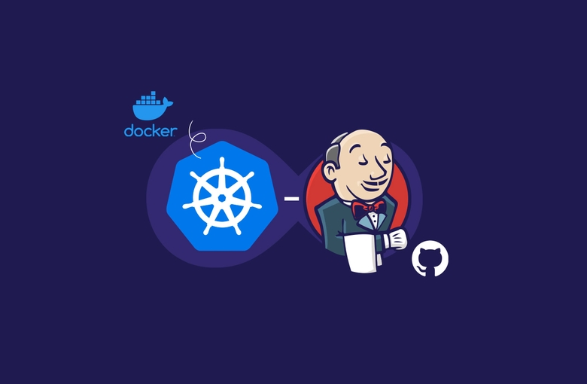
Automating Deployment Pipelines
Here, we dive into our deployment process, showcasing how changes were deployed on Minikube to a staging and production environments with minimal manual intervention. We highlight the automation implemented in our deployment pipelines, which improved efficiency, reliability, and consistency across environments.

Slide 8

Ensuring System Health
In this phase, we discuss our monitoring and logging strategies, which were instrumental in tracking the health and performance of our system in real-time. We present key metrics and indicators used to measure the success of our DevOps practices, demonstrating our commitment to continuous improvement.

Slide 9

Thank you!

